Slide 1
Academic Project Report
Design and Simulation of a 4-Bit Binary Arithmetic Calculator
Project Details
Institution Details
Student Name(s):
Aaryan - 2620030009
Neha - 2620030017
Rishith - 2620030021
Sruthi - 2620030044
Guide / Supervisor: Dr. Kartheek V
Department: CSE
College / Institution: KLH Bachupally
Academic Year: 2026 - 2027
Domain
Scope
Tool
Type
Digital Logic Design
4-Bit Binary Arithmetic
Logisim / Digital Simulator
Gate-Level Implementation

Slide 2

SECTION 1
Introduction
Background of Digital Logic Design
Why Arithmetic Calculators Are Foundational
All modern computing systems are founded on digital logic design — the discipline of constructing circuits from elementary logic gates (AND, OR, NOT) that perform Boolean operations. Every processor, memory unit, and communication interface ultimately reduces to combinations of these primitives following Boolean algebra rules.
The arithmetic logic unit (ALU) is the computational heart of every CPU. Hardware-level arithmetic circuits are the core building blocks of ALUs, and mastering their design is essential to understanding computer architecture at a fundamental level.
Binary Arithmetic as the Native Language
Complex processors emerge from combining basic gates (AND, OR, NOT) following Boolean algebra — a principle this project demonstrates end-to-end.
Digital systems communicate exclusively in binary. All computation — from simple addition to floating-point operations — reduces to binary addition and subtraction at the hardware level. Understanding binary arithmetic is therefore the gateway to understanding all digital computation.
Hardware from Simple Logic
Input → Process → Output Model
The power of digital design lies in composability: simple gates combine into half adders, half adders combine into full adders, full adders cascade into multi-bit arithmetic units, and those units form complete ALUs. This hierarchical abstraction is the foundation of all processor design.
Every digital system follows this fundamental paradigm: accept binary inputs, perform logic operations, and produce outputs. The arithmetic calculator studied in this project is a pure embodiment of this model.

Slide 3
SECTION 2
Problem Statement
Hardware-Level Circuit Necessity
Limitations of Manual Computation
Signed Number Representation Challenge
Software simulation alone cannot reveal how physical circuits perform arithmetic reliably at the gate level. A hardware-level design study is required to observe actual signal propagation, timing behavior, and gate interactions.
Manual binary arithmetic is inherently error-prone and, more critically, fails to illuminate circuit design principles. A working hardware implementation is needed to bridge theoretical arithmetic with practical logic design.
Representing negative numbers within a fixed-width binary format requires careful encoding. Two's complement is the industry-standard approach, but its correct implementation at the gate level demands systematic design and verification.
Overflow Detection in Fixed-Width Arithmetic
System Integration Complexity
Combining multiple full adders, mode-control logic, two's complement negation, and overflow detection into a single cohesive, correctly functioning system requires a systematic design methodology — not ad hoc assembly of components.
4-bit binary arithmetic operates within a constrained numeric range. Results that exceed this range produce silent errors without explicit overflow detection logic. Detecting and flagging overflow is critical for arithmetic correctness.

Slide 4
SECTION 3
Objectives
1
Design the Core Adder/Subtractor
1
Simulate the Complete Circuit
Design a complete 4-bit adder/subtractor circuit built entirely from fundamental logic gates: AND, OR, NOT, NAND, NOR, XOR, and XNOR.
Build and simulate the full system in a digital logic simulator (Logisim or Digital), observing signal behavior across all gate levels.
2
Implement Two's Complement
2
Verify Correctness
Apply two's complement representation for signed arithmetic, enabling the circuit to correctly process both positive and negative integer operands.
Validate the design through truth tables, structured test cases, and simulation results; confirm all outputs match mathematically expected values.
3
Detect Overflow Conditions
3
Document the Design Hierarchy
Design dedicated overflow detection logic and expose a 1-bit overflow flag output that correctly identifies out-of-range arithmetic results.
Produce a complete documentation trail: from primitive gates → half/full adders → 4-bit adder → integrated calculator system.

Slide 5

SECTION 4
Literature Survey & Existing Systems
Ripple-Carry Adders
Comparison of Adder Architectures
The ripple-carry adder (RCA) is the canonical gate-level design, where carry propagates sequentially through each bit stage. It is conceptually simple and uses minimal logic, making it the standard choice for educational implementations. The trade-off is propagation delay that grows linearly with bit width — a significant limitation for wide datapaths.
Architecture | Delay | Complexity
Ripple-Carry | O(n) | Low
Carry-Lookahead | O(log n) | High
Carry-Select | O(√n) | Medium
Carry-Lookahead Adders
Carry-lookahead adders (CLA) overcome RCA latency by computing carry signals in parallel using generate and propagate signals. This reduces critical path delay to O(log n) at the cost of substantially greater gate complexity — typically impractical for manual gate-level educational design.
Motivation for 4-Bit Scope
The 4-bit width is pedagogically optimal: it is wide enough to demonstrate multi-stage carry propagation, signed arithmetic, and overflow detection, yet narrow enough that truth tables, gate counts, and wiring remain tractable for manual design and classroom review.
ALU Designs in Real CPUs
Modern processor ALUs combine optimized adder structures with multiplexers to support multiple operations: ADD, SUB, AND, OR, XOR, and shift. Real ALU designs abstract the adder as a sub-component and layer control logic on top, exactly the hierarchy this project simulates at the 4-bit educational scale.
Existing educational designs often omit signed arithmetic. This project explicitly includes two's complement and overflow detection to provide a more complete learning experience.

Slide 6

SECTION 5
Proposed System
System Overview
The proposed system is a 4-bit binary arithmetic calculator that accepts two signed 4-bit operands and a 1-bit mode control signal, performs addition or subtraction using a unified adder/subtractor circuit, and outputs a 4-bit result plus a 1-bit overflow flag.
Input Specification
Two's Complement Core
A[3:0] — First 4-bit operand
B[3:0] — Second 4-bit operand
Mode — Control bit: 0 = Add, 1 = Subtract
Signed range: −8 to +7 (two's complement)
Subtraction is computed as A − B = A + (−B). Negation of B is achieved by XOR-ing each bit of B with the Mode signal, then injecting Mode as the initial carry-in — a clean one-circuit solution for both operations.
Overflow Detection
Output Specification
A dedicated XOR gate compares the carry-in and carry-out of the MSB (bit 3) stage.
Overflowing flag is asserted when these differ — indicating the result has exceeded the signed representable range.
OVF = Cin,MSB XOR Cout,MSB
Result[3:0] — 4-bit arithmetic result
OVF — 1-bit overflow flag
Gate-level implementation using Boolean sum-of-products expressions throughout
Inputs
Control Logic
4-bit Adder
Outputs

Slide 7

SECTION 6
System Architecture & Block Diagram
Architectural Components
Data Flow Summary
01
Signal | Width | Description
A[3:0] | 4-bit | First operand (signed)
B[3:0] | 4-bit | Second operand (signed)
Mode | 1-bit | 0 = Add, 1 = Subtract
B'[3:0] | 4-bit | B XOR Mode (conditional inversion)
Cin,0 | 1-bit | Mode (carry seed for two's complement)
S[3:0] | 4-bit | Arithmetic result output
OVF | 1-bit | Signed overflow flag
Input Stage
Two 4-bit input registers hold operands A[3:0] and B[3:0]. A single Mode bit selects add (0) or subtract (1).
02
B-Input XOR Array
Four XOR gates on B inputs: each B[i] XOR Mode passes B unchanged for addition or inverts B for subtraction. Mode is also injected as Cin of FA-0.
03
Ripple-Carry Adder Unit
Four full adders (FA-0 through FA-3) cascaded in sequence. Carry-out of FA-i connects to carry-in of FA-(i+1), propagating through all bit stages.
The XOR trick — feeding Mode into both the B input gates and carry-in — is what allows a single cascaded adder to serve as both an adder and a two's complement subtractor.
04
Overflow Detection Logic
Single XOR gate: OVF = Cin,3 XOR Cout,3. Compares MSB carry signals to detect signed overflow.
05
Output Stage
4-bit result S[3:0] and 1-bit overflow flag OVF are produced as final circuit outputs.

Slide 8
SECTION 7
Methodology & Implementation
1
2
1
Number Representation
Truth Tables
4-Bit Adder Construction
Define binary, hexadecimal, and two's complement encoding for 4-bit signed integers. Signed range: −8 (1000) to +7 (0111).
Derive truth tables for the half adder (2 inputs → Sum, Carry) and full adder (3 inputs: A, B, Cin → Sum, Cout). Full adder: 2³ = 8 rows.
Cascade four full adders (FA-0 to FA-3). Insert XOR gates on all B inputs: B'[i] = B[i] XOR Mode. Feed Mode into Cin of FA-0.
3
4
2
Boolean Expressions
Gate-Level Circuits
Overflow Detection Addition
Convert truth tables to sum-of-products (SOP) expressions. Full adder: Sum = A⊕B⊕Cin; Cout = AB + BCin + ACin.
Implement SOP expressions using AND, OR, and NOT gates. Recognize XOR gate patterns to simplify the sum output. Draw schematic for each sub-circuit.
Connect a single XOR gate: OVF = Cin,3 XOR Cout,3. Wire carry signals from FA-2 output and FA-3 output to this gate.
3
Simulation & Testing
Build the full circuit in Logisim / Digital. Apply a comprehensive set of test vectors covering addition, subtraction, boundary values, and overflow cases. Record all outputs.
Full Adder Truth Table
A | B | Cin | Sum | Cout
0 | 0 | 0 | 0 | 0
0 | 0 | 1 | 1 | 0
0 | 1 | 0 | 1 | 0
0 | 1 | 1 | 0 | 1
1 | 0 | 0 | 1 | 0
1 | 0 | 1 | 0 | 1
1 | 1 | 0 | 0 | 1
1 | 1 | 1 | 1 | 1

Slide 9
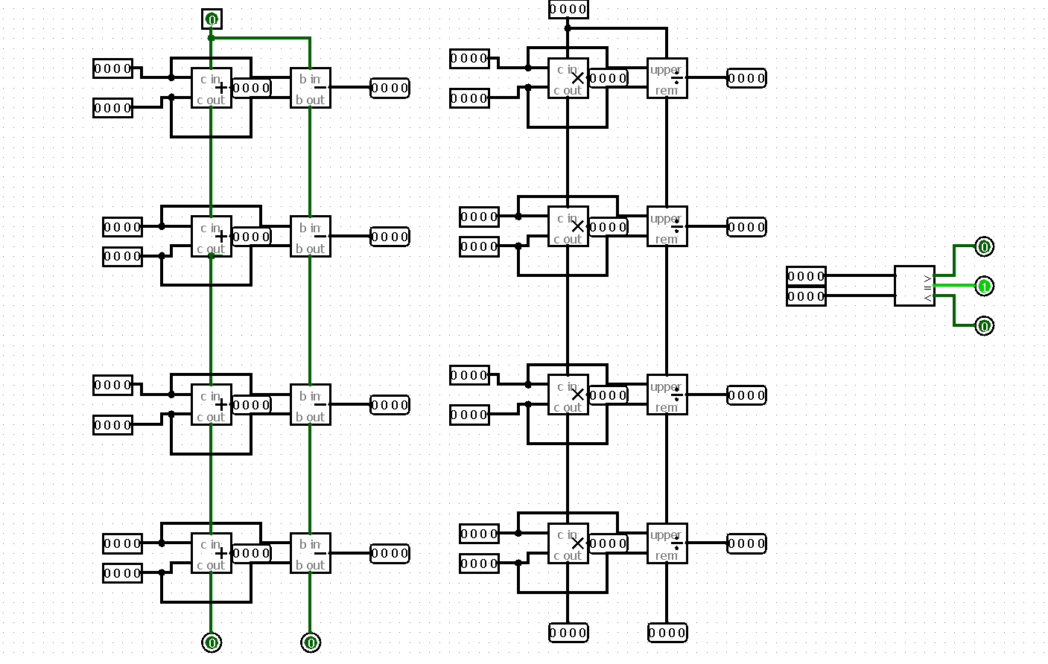
SECTION 8
Results & Discussion
Test Case Verification
Key Findings
Operation | A | B | Result | OVF
Addition | 0101 (+5) | 0011 (+3) | 1000 (+8)? | 1 ✓
Addition | 0011 (+3) | 0100 (+4) | 0111 (+7) | 0 ✓
Subtraction | 0101 (+5) | 0011 (+3) | 0010 (+2) | 0 ✓
Overflow | 0111 (+7) | 0001 (+1) | 1000 (−8) | 1 ✓
Neg. Overflow | 1000 (−8) | 1111 (−1) | 0111 (+7) | 1 ✓
Full Adder Verification
Full adder truth table verified across all 8 input combinations; sum and carry outputs correct in all cases.
Overflow Detection
OVF flag correctly identifies positive-overflow (two positive operands producing negative result) and negative-overflow cases.
Observed Limitations
All test cases produced results matching mathematically expected values. The overflow flag was correctly asserted in all out-of-range cases and de-asserted for all valid results, confirming correct implementation of the OVF = Cin,3 XOR Cout,3 logic.
Ripple-carry propagation delay grows linearly with bit width. Overflow detection assumes strict two's complement interpretation of inputs.
Performance Notes
Gate count and propagation delay are appropriate for educational demonstration. Circuit is not optimized for production speed or area.

Slide 10
SECTION 9
Conclusion
Design Achievements
Future Extensions
A complete 4-bit binary arithmetic calculator was successfully designed, implemented, and simulated from fundamental logic gates. All stated objectives were met in full.
Multiplication
Full ALU
Implement 4-bit multiplication using repeated addition or array multiplier structures.
Extend to a complete ALU supporting bitwise AND, OR, XOR, and shift operations via operation-select multiplexing.
Adder/subtractor circuit constructed at gate level
Two's complement signed arithmetic implemented
Overflow detection logic designed and verified
Circuit simulated and all test cases validated
Wider Datapaths
Key Learning
Scale design to 8-bit or 16-bit with carry-lookahead optimization to address ripple-carry delay limitations.
The project concretely demonstrated how complex arithmetic behavior emerges from simple Boolean logic, bridging the gap between Boolean algebra theory and physical gate-level circuit practice — a core competency in digital systems engineering.
Real-World Relevance
The principles demonstrated in this project apply directly to CPU ALU design, microcontroller arithmetic units, and digital signal processors. Every production processor implements these same fundamental operations at scale — making this project an authentic entry point into professional digital design.

